Slide 1
RELAY / CONCEPT STUDY
Relay
Care, coordinated.
A product narrative for clearer care-team handoffs
Fictional product • AI-assisted portfolio sample
AJ Tyler with AI assistance
01
Notes:
Original fictional portfolio concept created for AJ Tyler with Codex and OpenAI image generation on 2026-09-10. Relay is a fictional care-coordination software concept, not a client commission or operating product. All presentation copy and chart data are illustrative. Text and the chart are editable native slide objects.

Slide 2
RELAY / CONCEPT STUDY
The handoff
What happens after a visit?
A note needs review.
A change needs an owner.
The next shift needs context.
Design premise
Give each handoff a visible next action, a responsible person, and the context needed to continue.
AJ Tyler with AI assistance
02
Notes:
Original fictional portfolio concept created for AJ Tyler with Codex and OpenAI image generation on 2026-09-10. Relay is a fictional care-coordination software concept, not a client commission or operating product. All presentation copy and chart data are illustrative. Text and the chart are editable native slide objects.

Slide 3

RELAY / CONCEPT STUDY
A shared next action
Relay brings the task and its context together in one care-team workflow.
Capture the update
Assign responsibility
Review and close the loop
AJ Tyler with AI assistance
03
Notes:
Original fictional portfolio concept created for AJ Tyler with Codex and OpenAI image generation on 2026-09-10. Relay is a fictional care-coordination software concept, not a client commission or operating product. All presentation copy and chart data are illustrative. Text and the chart are editable native slide objects.

Slide 4
RELAY / CONCEPT STUDY
A week of handoffs
Illustrative queue volume by day
Synthetic example data for design demonstration. Counts are not customer or product results.
AJ Tyler with AI assistance
04
Notes:
Synthetic example only. Monday 18, Tuesday 24, Wednesday 16, Thursday 22, Friday 20 handoffs. These values were invented solely to demonstrate data visualization and are not empirical evidence. Native editable chart.

Slide 5
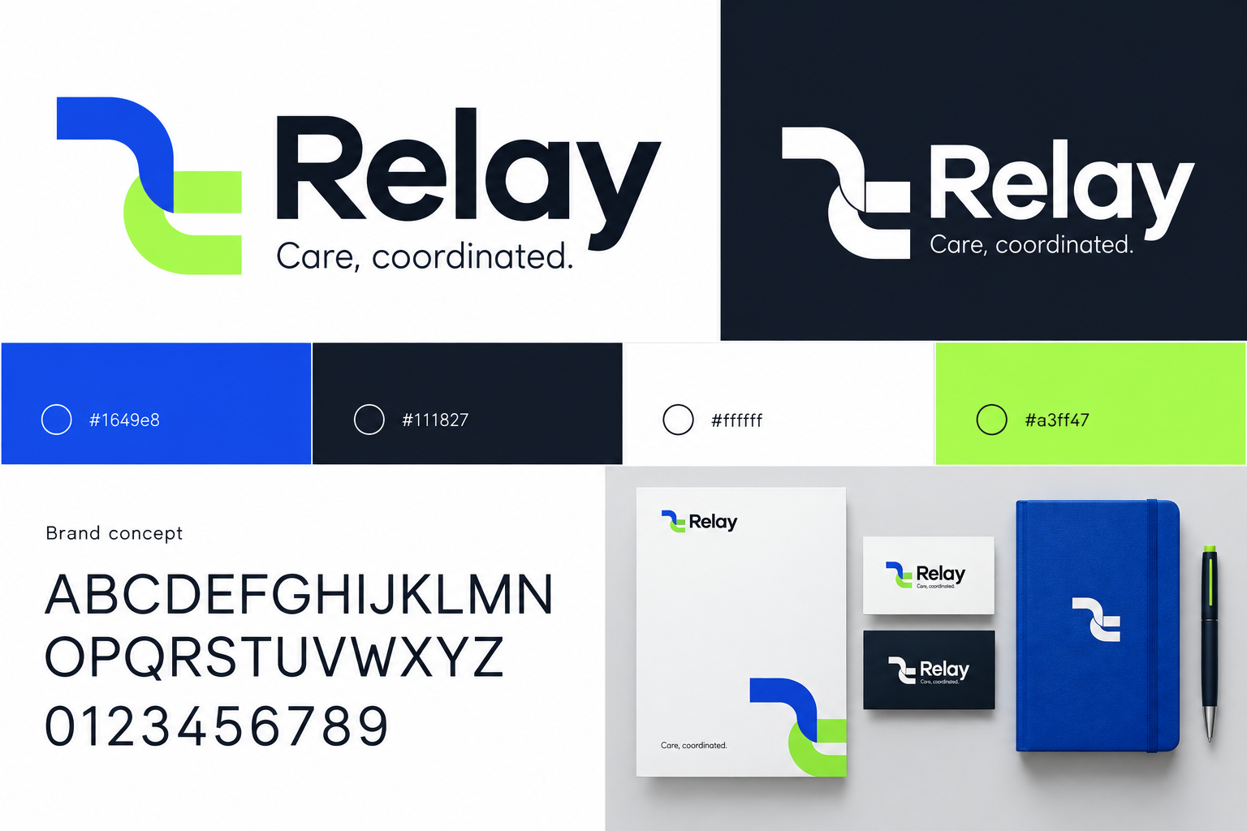
RELAY / CONCEPT STUDY
A visual system for Relay
Cobalt leads
Midnight supports long-form reading. Lime highlights a moment of transition.
Two exploratory wordmarks
The board and campaign explore different marks. Production use would require a final vector master.
AJ Tyler with AI assistance
05
Notes:
Original fictional portfolio concept created for AJ Tyler with Codex and OpenAI image generation on 2026-09-10. Relay is a fictional care-coordination software concept, not a client commission or operating product. All presentation copy and chart data are illustrative. Text and the chart are editable native slide objects.

Slide 6
RELAY / CONCEPT STUDY
A pilot before a promise
Test whether a clearer handoff helps the next person act with confidence.
Start with one care team.
Observe how work transfers between shifts.
Measure unresolved handoffs and missing context.
AJ Tyler with AI assistance
06
Notes:
Original fictional portfolio concept created for AJ Tyler with Codex and OpenAI image generation on 2026-09-10. Relay is a fictional care-coordination software concept, not a client commission or operating product. All presentation copy and chart data are illustrative. Text and the chart are editable native slide objects.

